Slide 1



Splash Screen

Slide 2
Lesson Menu
Five-Minute Check (over Lesson 2–7)
Then/Now
New Vocabulary
Example 1: Dashed Boundary
Example 2: Real-World Example: Solid Boundary
Example 3: Absolute Value Inequality

Slide 3

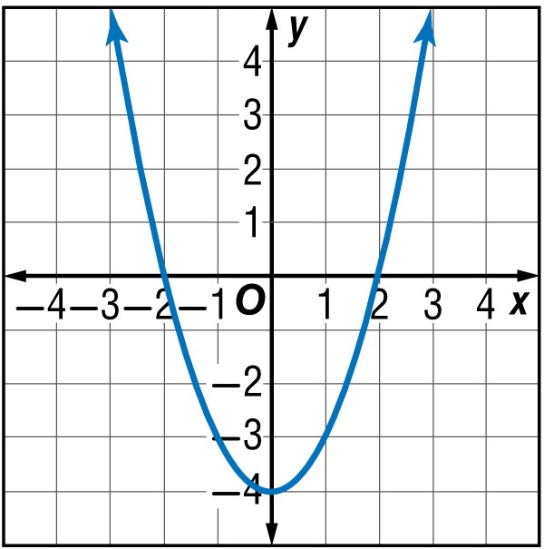
5-Minute Check 1
Identify the type of function represented by the graph.
A. piecewise
B. absolute value
C. quadratic
D. linear
A
B
C
D

Slide 4

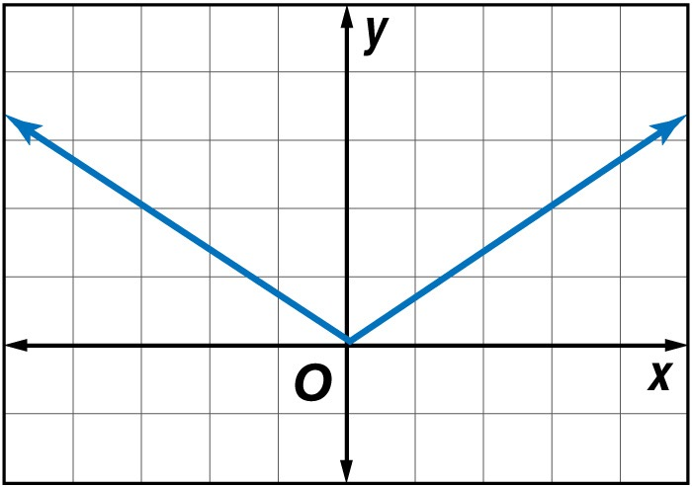
5-Minute Check 2
Identify the type of function represented by the graph.
A. piecewise
B. absolute value
C. quadratic
D. linear
A
B
C
D

Slide 5

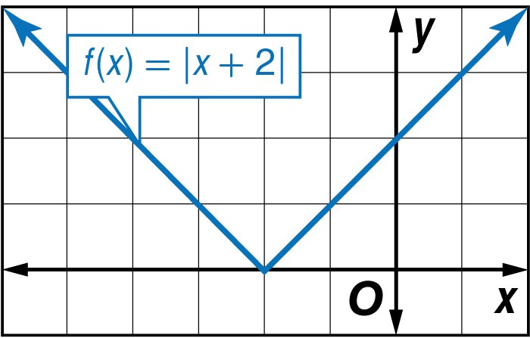
5-Minute Check 3
Graph f(x) = |x + 2|. Identify the domain and range.
A. D = all reals
R = all reals
B. D = all reals
R = all nonnegative reals
C. D = all reals less than –2
R = all reals
D. D = all reals
R = all reals less than –1
A
B
C
D

Slide 6
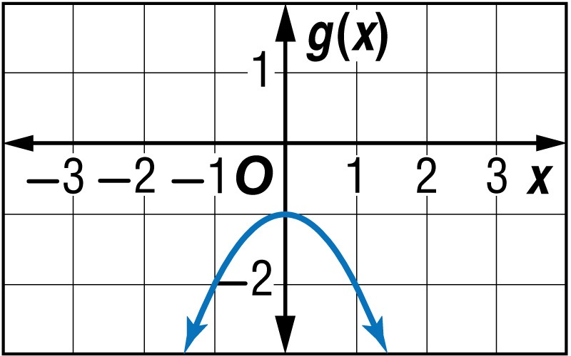

5-Minute Check 4
Graph g(x) = –x² – 1. Identify the domain and range.
A. D = all reals
R = all reals
B. D = all reals
R = all nonnegative reals
C. D = all reals less than –2
R = all reals
D. D = all reals
R = all reals less than –1
A
B
C
D

Slide 7

5-Minute Check 5
Which function below is a constant function?
A. f(x) = –x²
B. f(x) = –4
C. f(x) = –x³ + 4
D. f(x) = –[[x]] + 2
A
B
C
D

Slide 8


Then/Now
You described transformations on functions. (Lesson 2–7)
Graph linear inequalities.
Graph absolute value inequalities.

Slide 9


Vocabulary
linear inequality
boundary

Slide 10
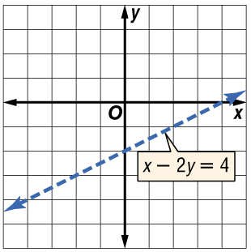
Example 1
Dashed Boundary
Graph x – 2y < 4.
The boundary is the graph of
x – 2y = 4. Since the inequality symbol is <, the boundary will be dashed.

Slide 11
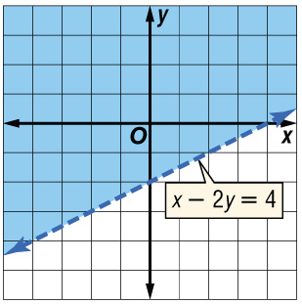
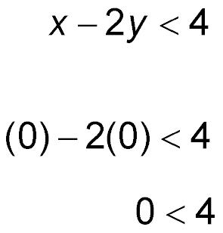
Example 1
Dashed Boundary
Graph x – 2y < 4.
Answer:
Test (0, 0).
Original inequality
(x, y) = (0, 0)
True
✓
Shade the region that contains (0, 0).

Slide 12


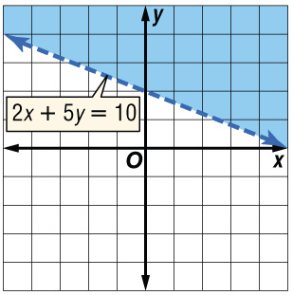
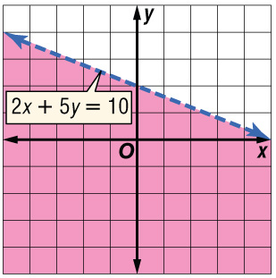
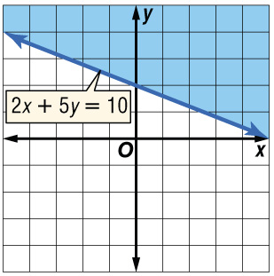
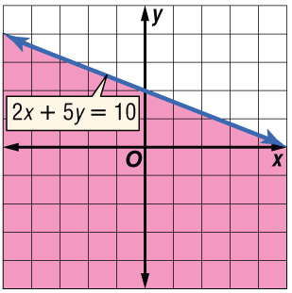
Example 1
Which graph is the graph of 2x + 5y > 10?
A. B.
C. D.
A
B
C
D

Slide 13
Example 2
Solid Boundary
A. EDUCATION One tutoring company advertises that it specializes in helping students who have a combined score on the SAT that is 900 or less.
Write an inequality to describe the combined scores of students who are prospective tutoring clients. Let x represent the verbal score and y the math score.
Let x be the verbal part of the SAT and let y be the math part. Since the scores must be 900 or less, use the ≤ symbol.

Slide 14
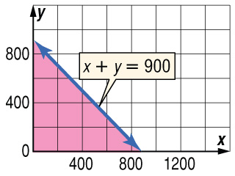
Example 2
Solid Boundary
Verbal math part
part and together are at most 900.
x
+
y
≤
900
Answer: x + y ≤ 900

Slide 15
Example 2
Solid Boundary
B. Does a student with verbal score of 480 and a math score of 410 fit the tutoring company’s guidelines?
The point (480, 410) is in the shaded region, so it satisfies the inequality.
Answer: Yes, this student fits the tutoring company’s guidelines.

Slide 16
Example 2
A. CLASS TRIP Two social studies classes are going on a field trip. The teachers have asked for parent volunteers to also go on the trip as chaperones. However, there is only enough seating for 60 people on the bus.
What is an inequality to describe the number of students and chaperones that can ride on the bus?
A
B
C
D
A. s + c ≥ 60
B. s + c ≤ 60
C. s + c < 60
D. s + c > 60

Slide 17
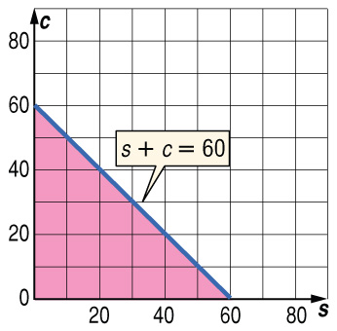
Example 2
B. Can 15 chaperones and 47 students ride on the bus?
A. Yes; the point (15, 47) lies in the shaded region.
B. No; the point (15, 47) lies outside the shaded region.
A
B

Slide 18

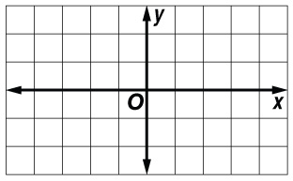
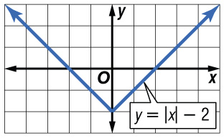
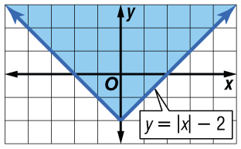
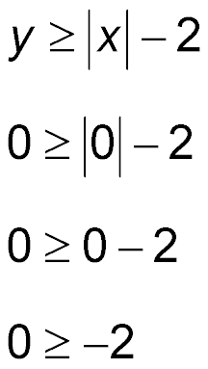

Example 3
Absolute Value Inequality
Since the inequality symbol is ≥, the graph of the related equation y = |x| – 2 is solid. Graph the equation.
Test (0, 0).
Original inequality
(x, y) = (0, 0)
Shade the region that contains (0, 0).
✓
True

Slide 19

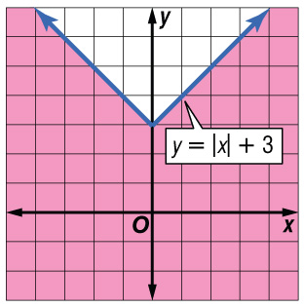
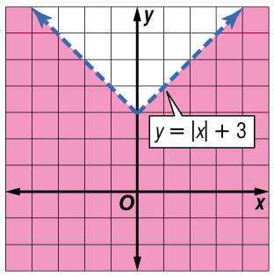
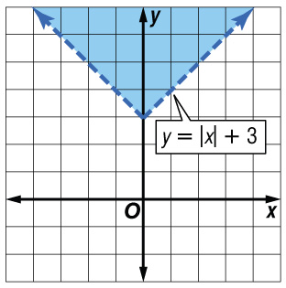

Example 3
A. B.
C. D.
A
B
C
D

Slide 20
The calculator can be used to check your work.
Step 1: You must have the equation in y = format
Step 2: You must know whether the graph is a solid/dashed line - the calculator cannot distinguish between them.
Step 3: Plug equation into Y=
Step 4: Scroll left (left, past y1) to choose less than (looks like bottom, left half is shaded) or greater than (looks like top, right half is shaded).
Step 5: Push Graph
Step 6: Check that your calculator graph and one on paper match.

Slide 21
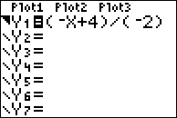
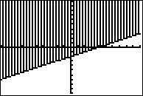
S
EXAMPLE: x - 2y < 4
Step 1: Solve for y:
-2y < -x + 4
y > (-x + 4)/(-2)
Step 2: Line should be dashed
Step 3 & 4: Y= should look like this
Step 5: Push Graph and should see the following: **Remember if you cannot see everything you want to see, change the WINDOW

Slide 22
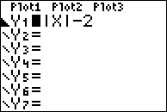
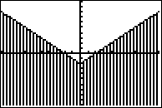
S
EXAMPLE: y < |x| - 2
Step 1: Solve for y: ALREADY DONE
Step 2: Line should be dashed
Step 3 & 4: Y= should look like this
Step 5: Push Graph and should see the following: **Remember if you cannot see everything you want to see, change the WINDOW

Slide 23
End of the Lesson

